Slide 1


Ratings prediction
Hinal Seth

Slide 2
Business Problem
We have a client who has a website where people write different reviews for technical products. Now they are adding a new feature to their website i.e. The reviewer will have to add stars(rating) as well with the review. The rating is out 5 stars and it only has 5 options available 1 star, 2 stars, 3 stars, 4 stars, 5 stars. Now they want to predict ratings for the reviews which were written in the past and they don’t have rating. So we, we have to build an application which can predict the rating by seeing the review.

Slide 3
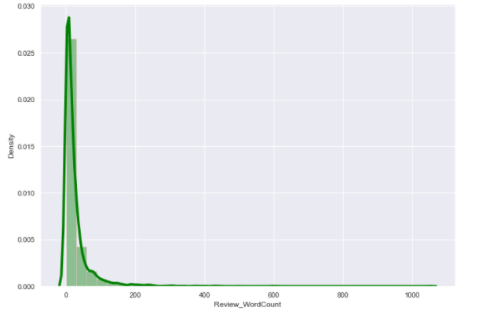
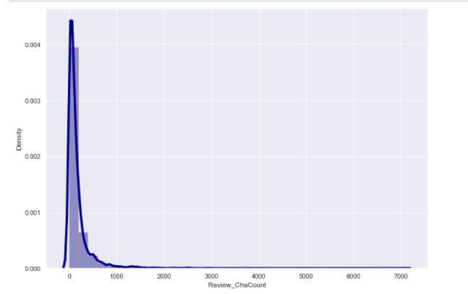
Exploratory Data Analysis
HISTOGRAM:
Word Count Character Count

Slide 4
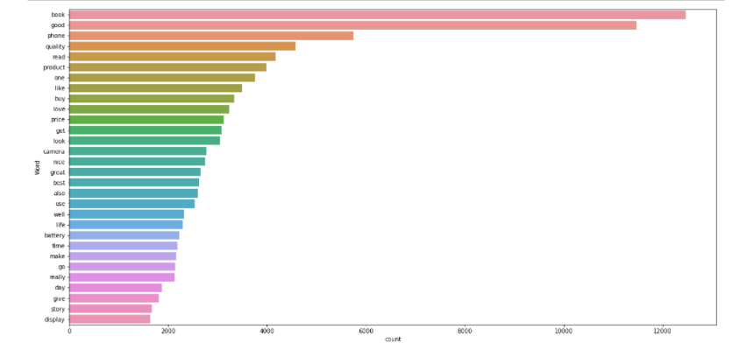
Bar Plot
Bar plot between Frequency of words and Most occurring words.
It represents that the words book and Good are occurred the most followed by phone and quality.

Slide 5
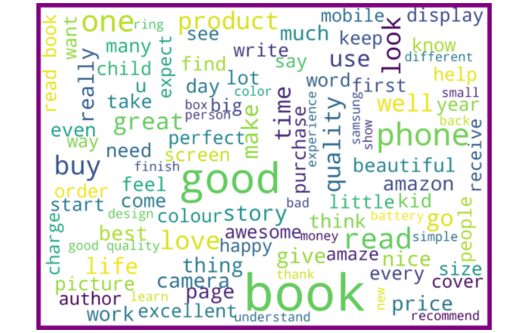
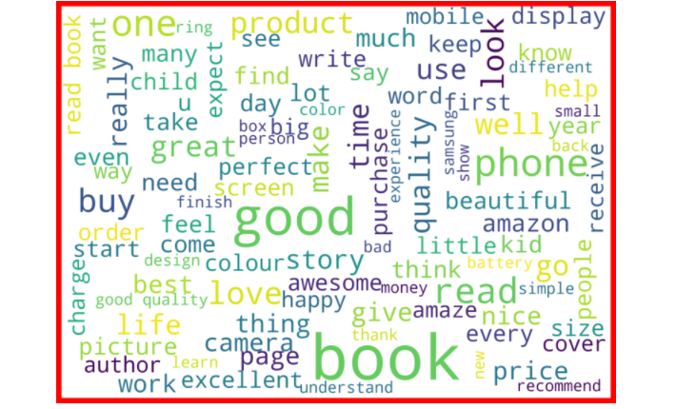
Word Cloud
Rating 1 Rating 2

Slide 6
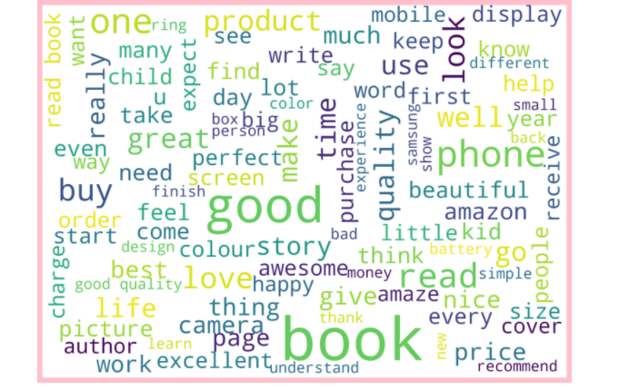
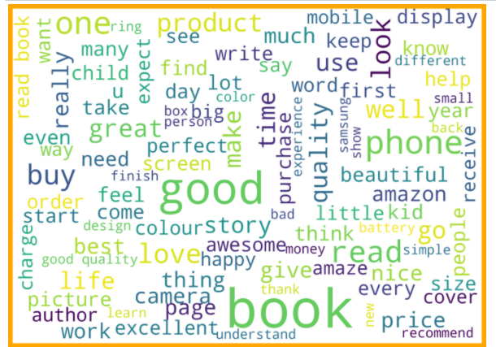
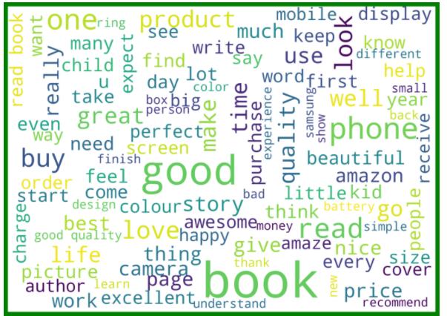
Rating 3 Rating 4 Rating 5

Slide 7
Data Preprocessing
We first looked for the null values present in the dataset. We noticed that there were no null values present in our dataset. Then we performed text processing.
Data usually comes from a variety of sources and often in different formats. For this reason transforming your raw data is essential.
However, this is not a simple process, as text data often contains redundant and repetitive words. This means that processing the text data is the first step in our solution.
The fundamental steps involved in text pre-processing are Cleaning the raw data Tokenizing the cleaned data.

Slide 8
Pre-processing involved the following steps:
➢ Removing Punctuations and other special characters
➢ Removing Stop Words
➢ Stemming and Lemmatising
➢ Applying TFIDF Vectorizer
➢ Balancing the dataset through smote technique
•Some very large length comments can be seen, in our dataset.
•These pose serious problems like adding excessively more words to the training dataset, causing training time to increase and accuracy to decrease.

Slide 9
Assumptions Related to Problem Under Consideration
By looking into the target variable label we assumed that it was a Multiclass classification type of problem.
We observed that dataset was imbalance so we will have to balance the dataset for better outcome.

Slide 10
Model Building
We must anticipate Ratings in this nlp-based project, which is a multiclassification task. I used TFIDF vectorizer to turn the text into vectors, separated our feature and labels, and then built the model using One Vs Rest Classifier. I choose RandomForestClassifier as the best suited algorithm for our final model among all the algorithms. I have chosen it since it performs well when compared to other algorithms when assessing with different metrics. I have used and tested the following methods:
MultinomialNB
Logistic Regression
BernoulliNB
SGDClassifier
GradientBoostingClassifier
RandomForestClassifier
DecisionTreeClassifier

Slide 11
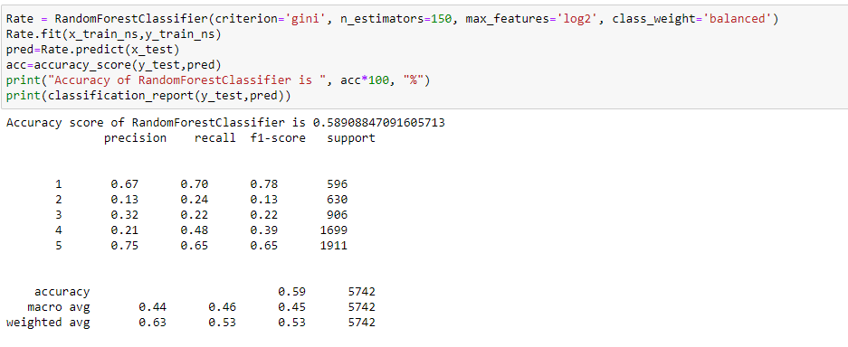
Final Model

Slide 12
Conclusion
In this project we have tried to detect the Ratings in commercial websites on a scale of 1 to 5 on the basis of the reviews given by the users.
We made use of natural language processing and machine learning algorithms in order to do so.
We interpreted that Random forest classifier model is giving us best results

Slide 13



This Photo by Unknown Author is licensed under CC BY-SA
This Photo by Unknown Author is licensed under CC BY-NC-ND

